Slide 1
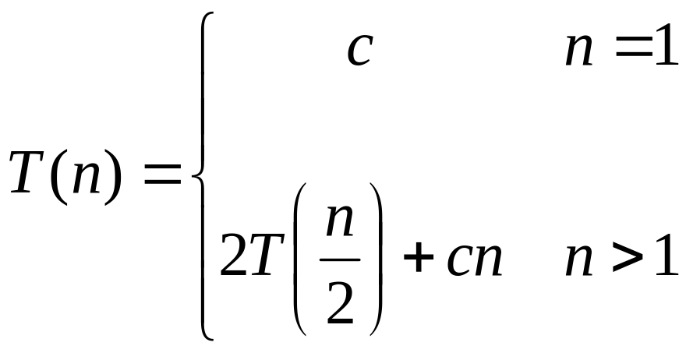
Recurrences
The expression:
is a recurrence.
  Recurrence: an equation that describes a function in terms of its value on smaller functions
Analysis of Algorithms

Slide 2

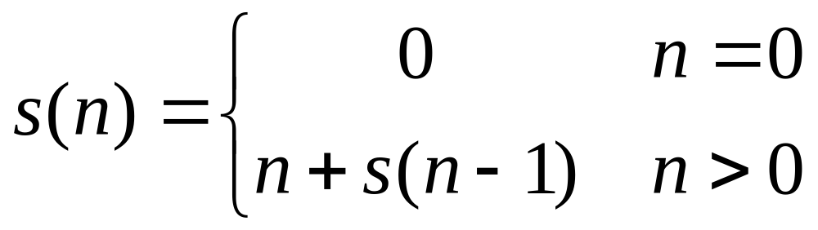
Recurrence Examples
Analysis of Algorithms

Slide 3
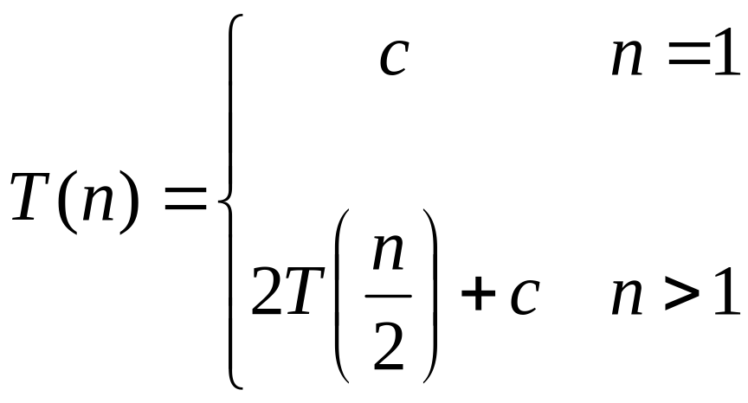

Recurrence Examples
Analysis of Algorithms

Slide 4
Solving Recurrences
Substitution method
    “making a good guess method”
Iteration method
  (Repeated Substitution)
Master method
Analysis of Algorithms

Slide 5
Substitution Method
“making a good guess method”
Guess the form of the answer, then use induction to find the constants and show that solution works
Examples:
  T(n) = 2T(n/2) + Θ(n) → T(n) = Θ(n lg n)
  T(n) = 2T(⎣n/2⎦) + n → T(n) = Θ(n lg n)
  T(n) = 2T(⎣n/2⎦+ 17) + n → Θ(n lg n)
Analysis of Algorithms

Slide 6
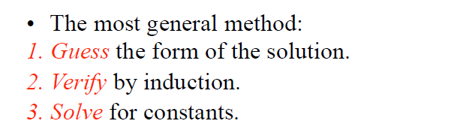
Substitution Method
Analysis of Algorithms

Slide 7
Substitution Method
T(n) = 2 T(⎣n/2⎦) + n
Guess: O(n lgn)
Verify
  Inductive Hypothesis: T(n) ≤ c n lgn for appropriate choice of c > 0
  Prove that T(n) ≤ c n lgn for appropriate choice of c > 0
Use induction:
Assume T(⎣n/2⎦) ≤ c ⎣n/2⎦ lg(⎣n/2⎦) holds
Show T(n) ≤ c n lgn
Analysis of Algorithms

Slide 8
Substitution Method
T(n) = 2 T(⎣n/2⎦) + n
T(n) ≤ 2 c ⎣n/2⎦ lg(⎣n/2⎦) + n apply IH
≤ c n lg(n/2) + n
= c n lgn – c n lg2 + n
= c n lgn – c n + n
≤ c n lgn when c ≥ 1
Analysis of Algorithms

Slide 9
Substitution Method
T(n) = T(⎣n/2⎦) + T(⎡n/2⎤) + 1
Guess: O(n)
Try to show T(n) ≤ cn for appropriate constant c (IH)
T(n) = T(⎣n/2⎦) + T(⎡n/2⎤) + 1
T(n) ≤ c ⎣n/2⎦ + c ⎡n/2⎤ + 1
= cn + 1
but does not imply T(n) ≤ c n
So, our IH does not work
      go to O(n²) or
      change IH ➔ T(n) ≤ cn – b where b ≥ 0
Analysis of Algorithms

Slide 10
Substitution Method
      IH ➔ T(n) ≤ cn – b where b ≥ 0 (subtracting lower order term)
T(n) = T(⎣n/2⎦) + T(⎡n/2⎤) + 1
T(n) ≤ ( c ⎣n/2⎦ - b ) + ( c ⎡n/2⎤ - b )+ 1
= cn - 2b + 1
≤ cn - b when b ≥ 1
Analysis of Algorithms

Slide 11
Substitution Method – Avoiding Pitfalls
T(n) = 2 T(⎣n/2⎦) + n
Guess: O(n) ?? (wrong guess)
T(n) ≤ cn ( IH )
T(n) ≤ 2 c ⎣n/2⎦ + n apply IH
≤ c n + n
= O(n) ⬅ WRONG
Since c is constant, we have not prove that the exact form of IH,
i.e. T(n) ≤ cn
Analysis of Algorithms

Slide 12
Substitution Method – Changing Variables
T(n) = 2 T( ⎣√n⎦ ) + lg n ➔ a difficult recurrence
Rename m as lgn yields
T(2^{m}) = 2 T(2^{m/2}) + m
Rename S(m) = T(2^{m})
S(m) = 2 T(m/2) + m
Similar to our previous recurrence
➔ O(m lgm)
Change back S(m) to T(n)
T(n) = T(2^{m}) = S(m) = O(m lgm)
➔ O(lgn lg lg n)
Analysis of Algorithms

Slide 13
Iteration Method
Another option is what the book calls the “iteration method”
  Expand the recurrence
  Work some algebra to express as a summation
  Evaluate the summation
Analysis of Algorithms

Slide 14
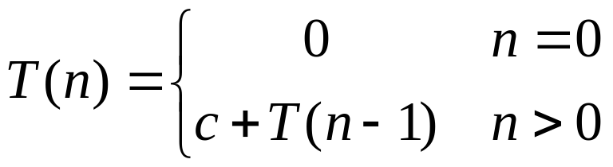
Iteration Method
T(n) = c + T(n-1)
c + c + T(n-2)
2c + T(n-2)
2c + c + T(n-3)
3c + s(n-3)
…
kc + T(n-k) = ck + T(n-k)
So far for n >= k we have
  T(n) = ck + T(n-k)
What if k = n?
  T(n) = cn + T(0) = cn ➔ O(n)
Analysis of Algorithms

Slide 15
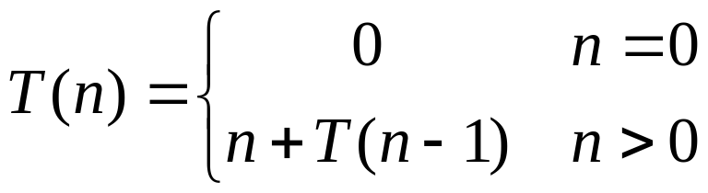
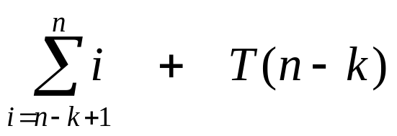
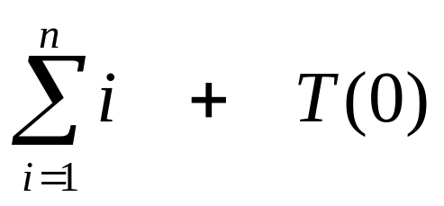
Iteration Method
T(n) = n + T(n-1)
n + (n-1) + T(n-2)
n + (n-1) + (n-2) + T(n-3)
…
What if k = n?
  ➔ O(n²)
Analysis of Algorithms

Slide 16
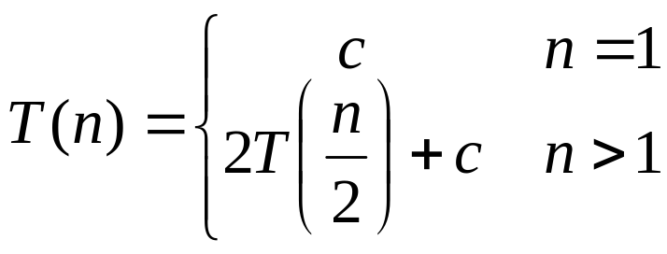
Iteration Method
T(n) = 2T(n/2) + c
2(2T(n/2/2) + c) + c
2²T(n/2²) + 2c + c
2²(2T(n/2²/2) + c) + 3c
2³T(n/2³) + 4c + 3c
2³T(n/2³) + 7c
2³(2T(n/2³/2) + c) + 7c
2⁴T(n/2⁴) + 15c
…
2^{k}T(n/2^{k}) + (2^{k} - 1)c
Analysis of Algorithms

Slide 17
Iteration Method
So far for n > 2k we have
  T(n) = 2^{k}T(n/2^{k}) + (2^{k} - 1)c
What if k = lg n?
  T(n) = 2^{lg n} T(n/2^{lg n}) + (2^{lg n} - 1)c
  = n T(n/n) + (n - 1)c
  = n T(1) + (n-1)c
  = nc + (n-1)c = (2n - 1)c
  ➔ O(n)
Analysis of Algorithms

Slide 18
Recursion-Tree Method
A recursion tree models the costs (time) of a recursive execution of an algorithm.
The recursion tree method is good for generating guesses for the substitution method.
The recursion-tree method promotes intuition.
Analysis of Algorithms

Slide 19
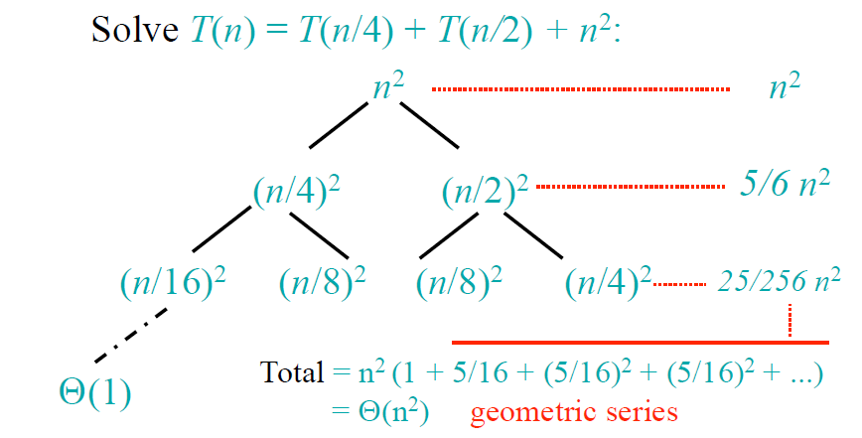
Recursion-Tree Method
Analysis of Algorithms

Slide 20
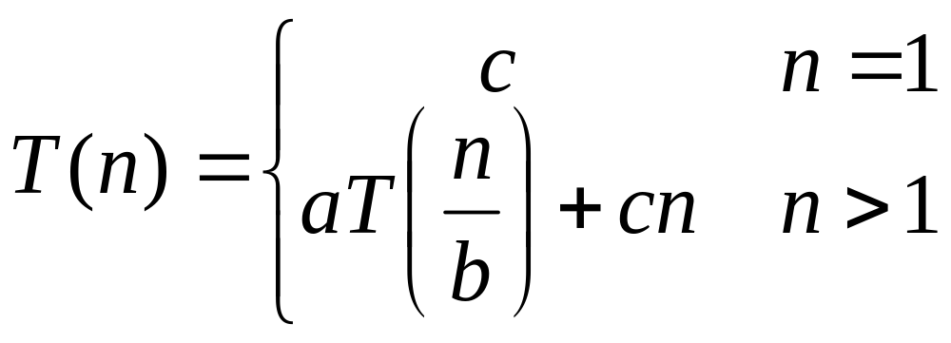
Solving Recurrences
Try to solve following recurrence equation
to understand Master Theorem
Analysis of Algorithms

Slide 21
Solving Recurrence
T(n) =
aT(n/b) + cn
a(aT(n/b/b) + cn/b) + cn
a²T(n/b²) + cna/b + cn
a²T(n/b²) + cn(a/b + 1)
a²(aT(n/b²/b) + cn/b²) + cn(a/b + 1)
a³T(n/b³) + cn(a²/b²) + cn(a/b + 1)
a³T(n/b³) + cn(a²/b² + a/b + 1)
…
a^{k}T(n/b^{k}) + cn(a^{k-1}/b^{k-1} + a^{k-2}/b^{k-2} + … + a²/b² + a/b + 1)
Analysis of Algorithms

Slide 22
Solving Recurrence
So we have
  T(n) = a^{k}T(n/b^{k}) + cn(a^{k-1}/b^{k-1} + ... + a²/b² + a/b + 1)
For k = log_{b} n
  n = b^{k}
  T(n) = a^{k}T(1) + cn(a^{k-1}/b^{k-1} + ... + a²/b² + a/b + 1)
  = a^{k}c + cn(a^{k-1}/b^{k-1} + ... + a²/b² + a/b + 1)
  = ca^{k} + cn(a^{k-1}/b^{k-1} + ... + a²/b² + a/b + 1)
  = cna^{k} /b^{k} + cn(a^{k-1}/b^{k-1} + ... + a²/b² + a/b + 1)
  = cn(a^{k}/b^{k} + ... + a²/b² + a/b + 1)
Analysis of Algorithms

Slide 23
Solving Recurrence
So with k = log_{b} n
  T(n) = cn(a^{k}/b^{k} + ... + a²/b² + a/b + 1)
What if a = b?
  T(n) = cn(k + 1)
  = cn(log_{b} n + 1)
  = Θ(n log n)
Analysis of Algorithms

Slide 24
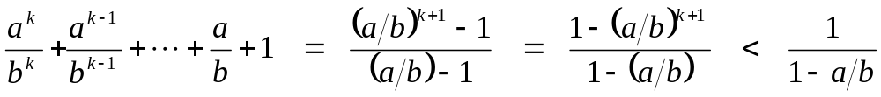
Solving Recurrence
So with k = log_{b} n
  T(n) = cn(a^{k}/b^{k} + ... + a²/b² + a/b + 1)
What if a < b?
  Recall that Σ(x^{k} + x^{k-1} + … + x + 1) = (x^{k+1} -1)/(x-1)
  So:
  T(n) = cn ·Θ(1) = Θ(n)
Analysis of Algorithms

Slide 25
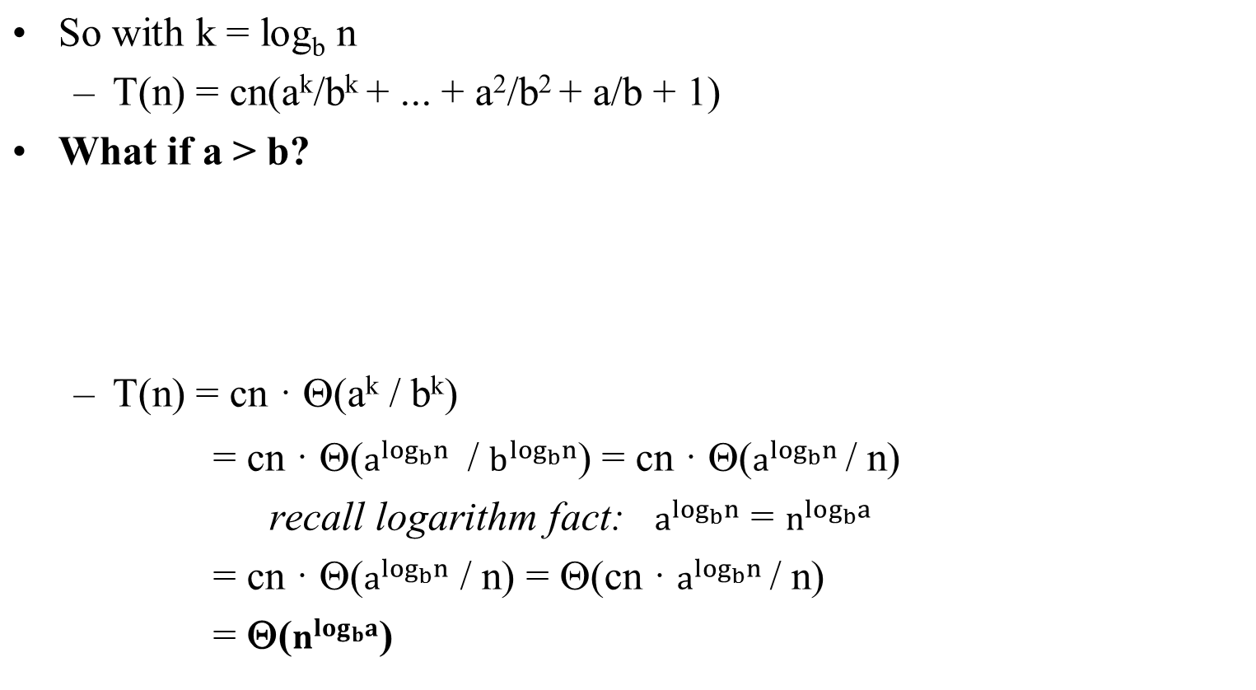
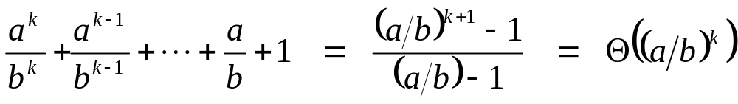
Solving Recurrence
Analysis of Algorithms

Slide 26
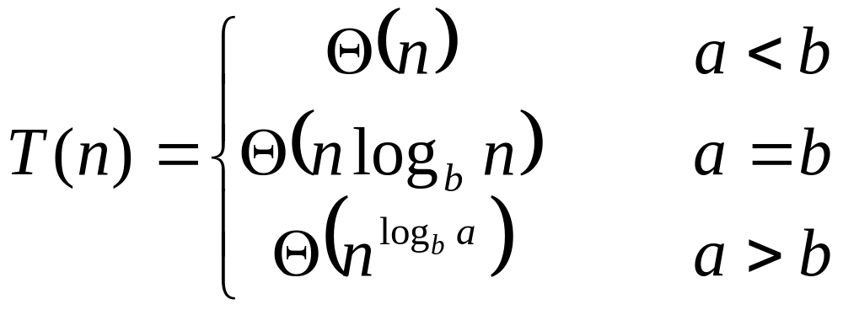
Solving Recurrence
So…
Analysis of Algorithms

Slide 27
The Master Theorem
Given: a divide and conquer algorithm
  An algorithm that divides the problem of size n into a subproblems, each of size n/b
  Let the cost of each stage
  (i.e., the work to divide the problem + combine solved subproblems) be described by the function f(n)
Then, the Master Theorem gives us a cookbook for the algorithm’s running time:
Analysis of Algorithms

Slide 28
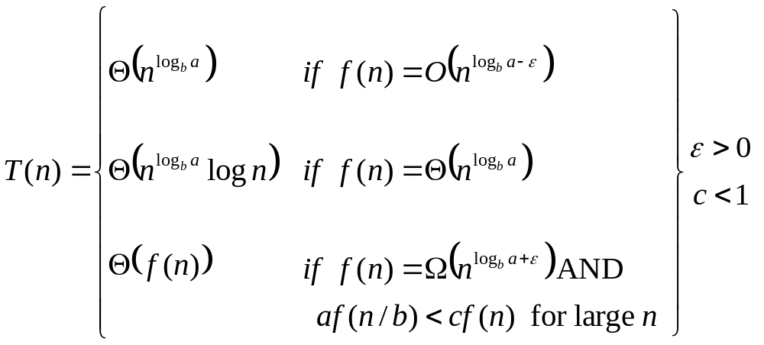
The Master Theorem
if T(n) = aT(n/b) + f(n) then
CASE 1 : asymptotically smaller
CASE 2 : asymptotically equal
CASE 3 : asymptotically greater
Analysis of Algorithms

Slide 29
The Master Theorem – Does Not Apply
f(n) is smaller than function, but NOT asymptotically smaller
f(n) is greater than function, but NOT asymptotically greater
CASE 3 condition does not hold
Analysis of Algorithms

Slide 30
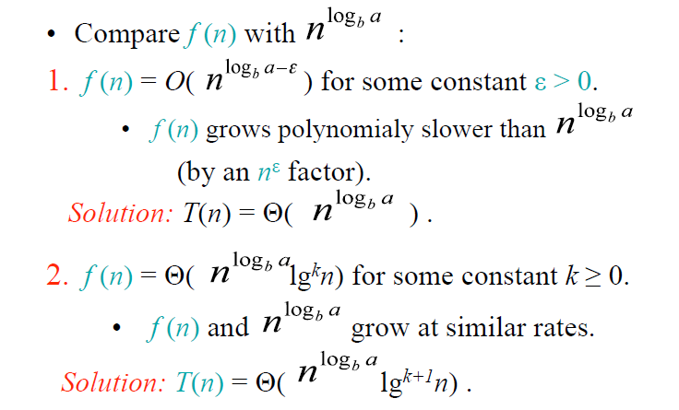
Master Method – Three Cases
Analysis of Algorithms

Slide 31
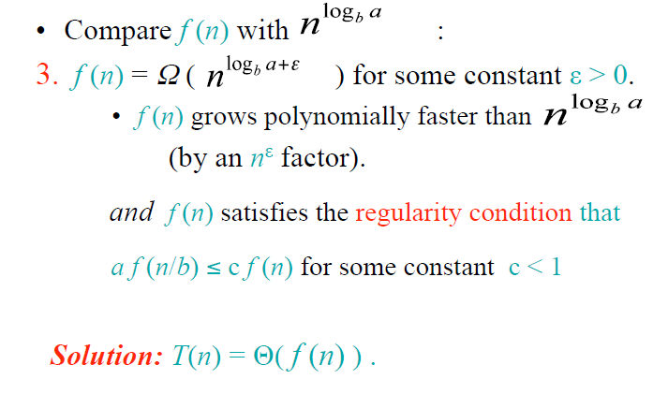
Master Method – Three Cases
Analysis of Algorithms

Slide 32
Using The Master Method
T(n) = 9T(n/3) + n
  a=9, b=3, f(n) = n
  n ^{log}_{b} ª = n^{log}₃ ⁹ = Θ(n²)
  Since f(n) = O(n ^{log}₃ ^{9 - ε}), where ε=1, CASE 1 applies:
  Thus the solution is T(n) = Θ(n²)
Analysis of Algorithms

Slide 33
Using The Master Method
T(n) = T(2n/3) + 1
  a=1, b=3/2, f(n) = 1
  n ^{log}_{b}ª = n^{log}_{3/2}¹ = n⁰ = 1
  Since f(n) = Θ(n ^{log}_{b}ª) = Θ(1) , CASE 2 applies:
  Thus the solution is T(n) = Θ(lgn)
Analysis of Algorithms

Slide 34
Using The Master Method
T(n) = 3T(n/4) + nlgn
  a=3, b=4, f(n) = nlgn
  n ^{log}_{b}ª = n^{log}₄³ = n^{0.793}
  Since f(n) = Ω(n ^{log}₄^{3+ε}) where ε is approximately 0.2
  CASE 3 applies:
  For sufficiently large n
  af(n/b)=3f(n/4)lg(n/4) ≤ (3/4)nlgn = cf(n) for c=3/4
  By case 3
  Thus the solution is T(n) = Θ(nlgn)
Analysis of Algorithms

Slide 35
Using The Master Method
Master theorem does NOT apply to the recurrence
T(n) = 2T(n/2) + nlgn
  a=2, b=2, f(n) = nlgn
  n ^{log}_{b}ª = n
  Since f(n) = nlgn is asymptotically larger than n ^{log}_{b}ª = n
  CASE 3 applies:
  But f(n) = nlgn is NOT polynomially larger than n ^{log}_{b}ª = n
  The ratio f(n) / n ^{log}_{b}ª = (nlgn) / n is asymptotically less than n^{ε}
  For any positive constant ε
  So the recurrence falls the gap between case 2 and case 3
Analysis of Algorithms

Slide 36
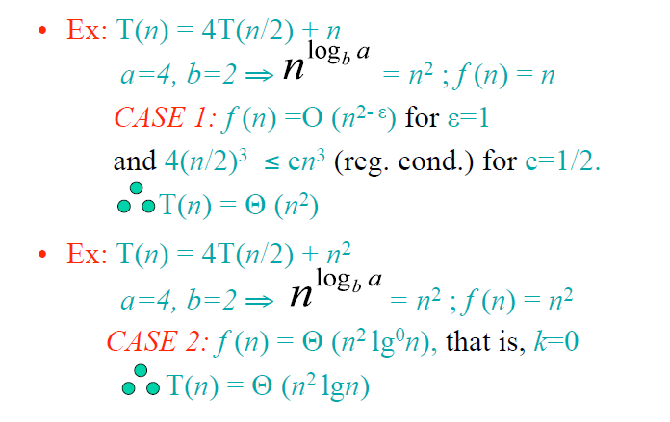
Using The Master Method
Analysis of Algorithms

Slide 37
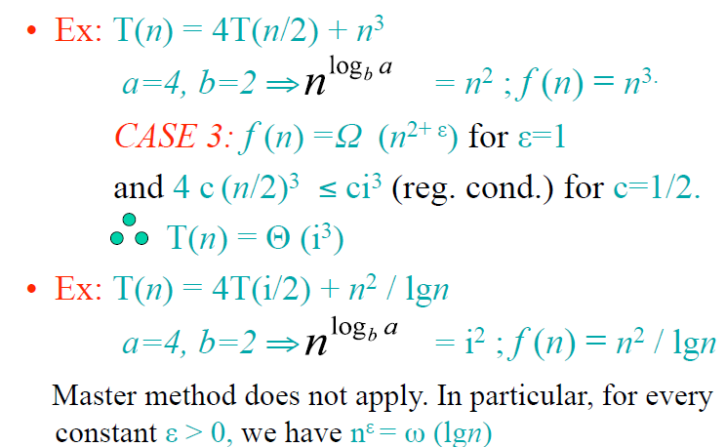
Using The Master Method
Analysis of Algorithms

Slide 38
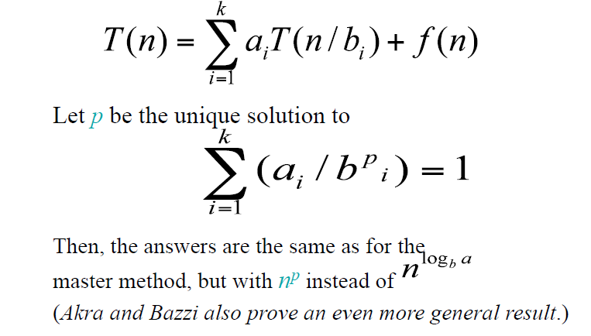
General Method (Akra-Bazzi)
Analysis of Algorithms

Slide 39
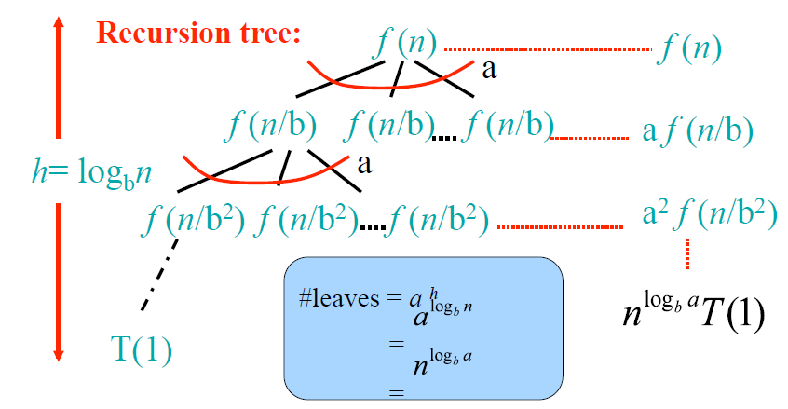
Idea of Master Theorem
Analysis of Algorithms

Slide 40
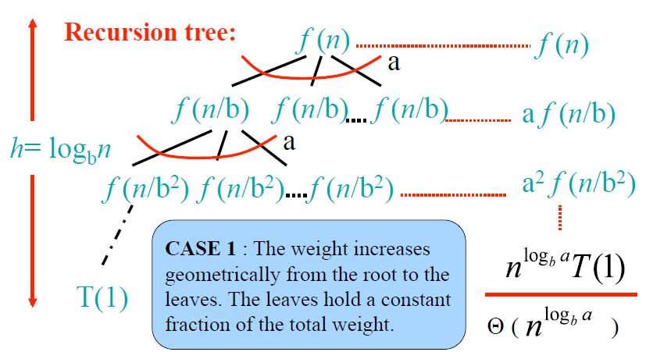
Idea of Master Theorem
Analysis of Algorithms

Slide 41
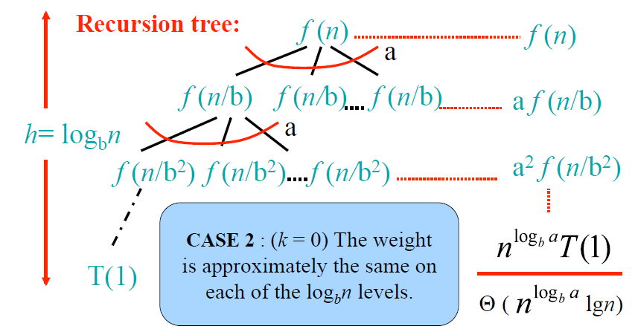
Idea of Master Theorem
Analysis of Algorithms

Slide 42
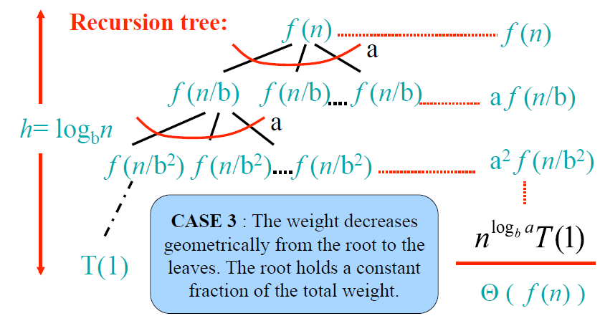
Idea of Master Theorem
Analysis of Algorithms

Slide 43
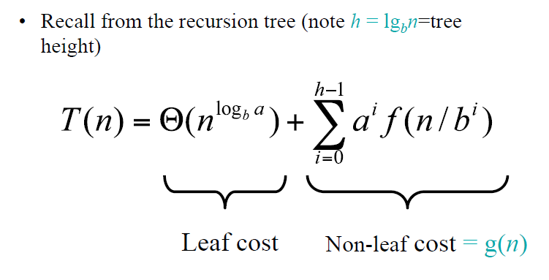
Proof of Master Theorem:
Case 1 and Case 2
Analysis of Algorithms

Slide 44
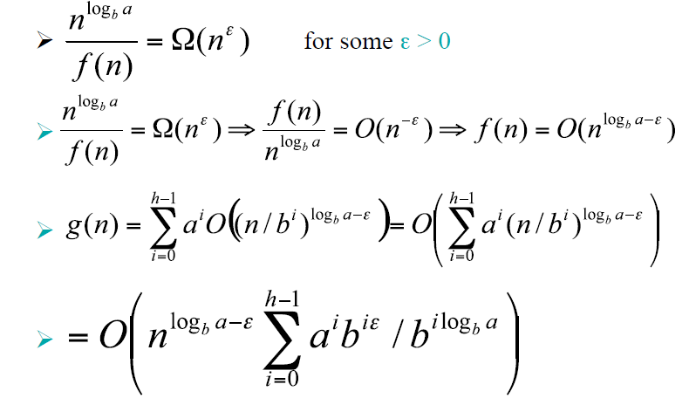
Proof of Case 1
Analysis of Algorithms

Slide 45
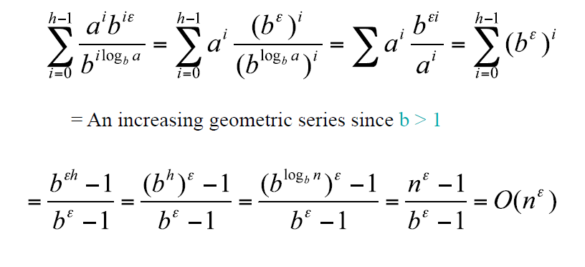
Case 1 (cont’)
Analysis of Algorithms

Slide 46
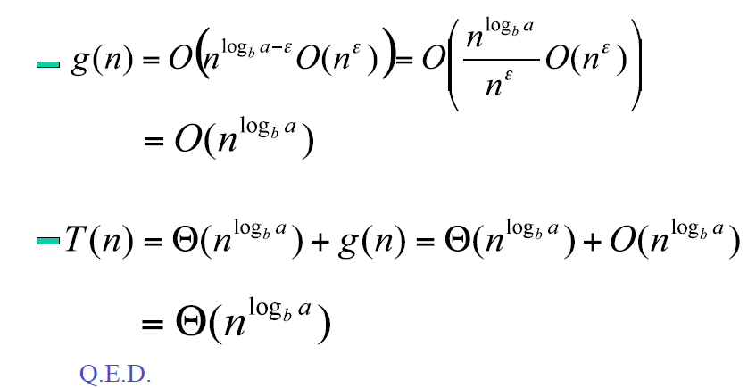
Case 1 (cont’)
Analysis of Algorithms

Slide 47
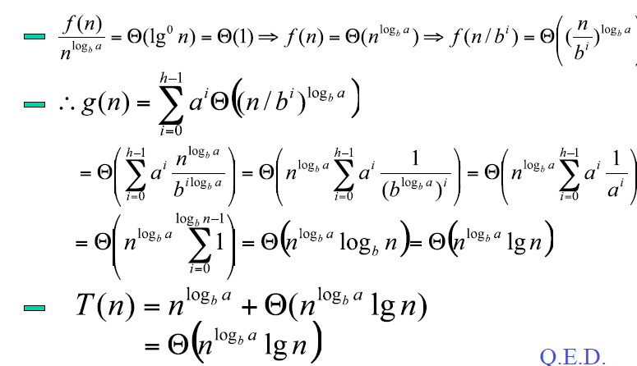
Proof of Case 2 (limited to k=0)
Analysis of Algorithms

Slide 48
The Divide-and-Conquer Design
Paradigm
1. Divide the problem (instance) into subproblems.
2. Conquer the subproblems by solving them recursively.
3. Combine subproblem solutions.
T(n) is a recurrence equation
Analysis of Algorithms

Slide 49
Example: Merge Sort
1. Divide: Trivial.
2. Conquer: Recursively sort 2 subarrays.
3. Combine: Linear- time merge.
T(n) = 2 T(n/2) + O(n)
# subproblems subproblem size work dividing
and combining
Analysis of Algorithms

Slide 50
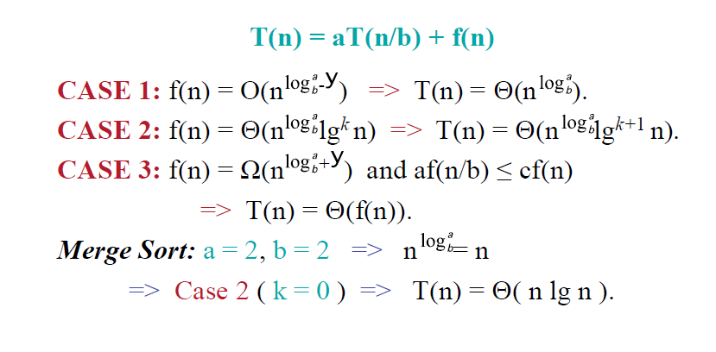
Master Theorem – Merge Sort
Analysis of Algorithms

Slide 51
Binary Search
Find an element in a sorted array:
1. Divide: Check middle element.
2. Conquer: Recursively search 1 subarray.
3. Combine: Trivial.
Example: Find 9
3 5 7 8 9 12 15
Analysis of Algorithms

Slide 52
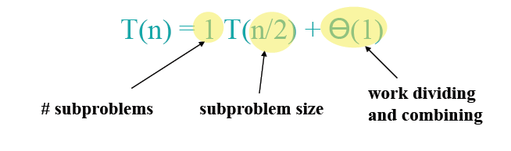

Master Theorem - Binary Search
CASE 2 (k=0) ➔ T(n) = Θ(lgn)
Analysis of Algorithms

Slide 53
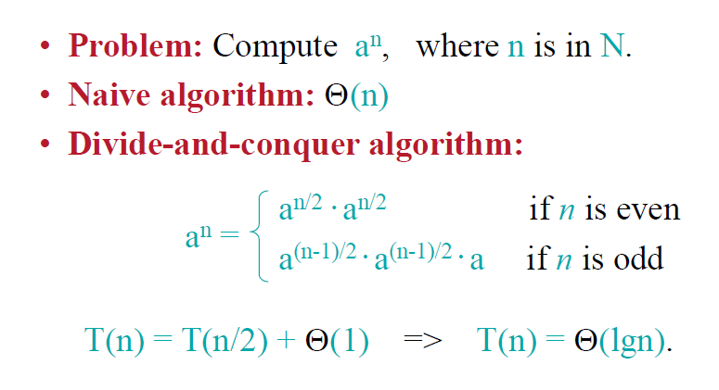
Powering a Number
Analysis of Algorithms

Slide 54
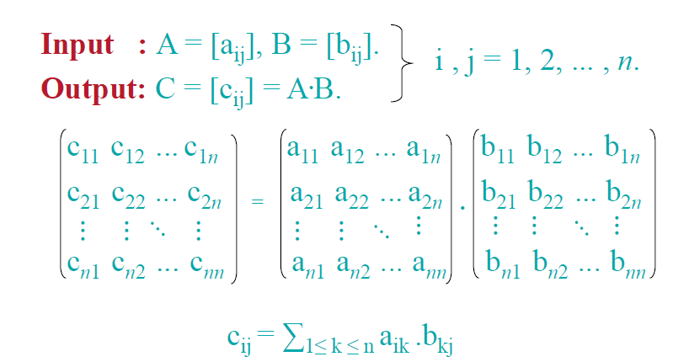
Matrix Multiplication
Analysis of Algorithms

Slide 55
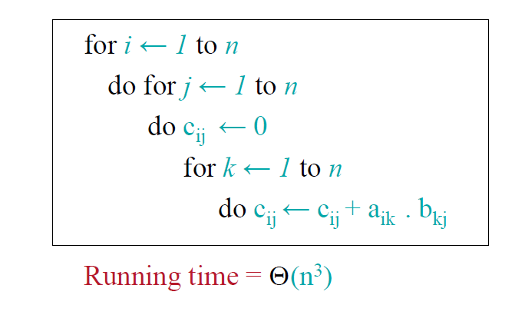
Matrix Multiplication – Standard Algorithm
Analysis of Algorithms

Slide 56
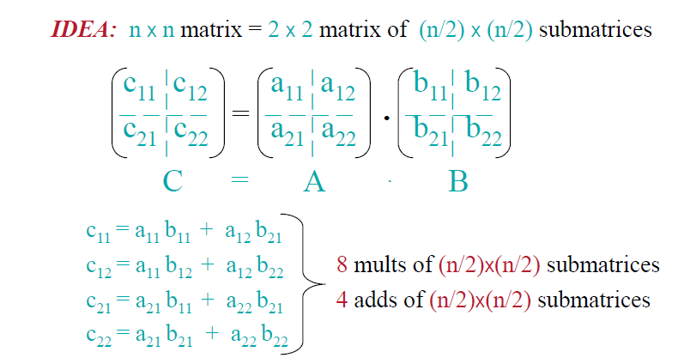
Matrix Multiplication –
Divide-and-Conquer Algorithm
Analysis of Algorithms

Slide 57
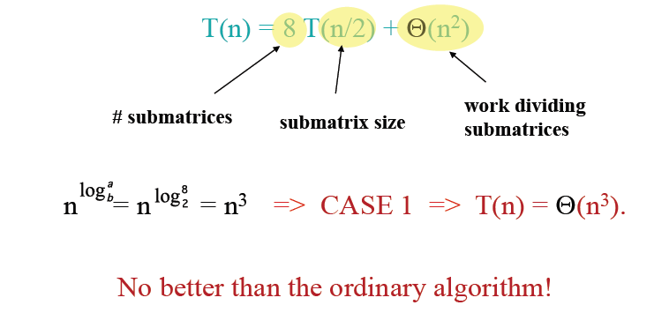
Matrix Multiplication - Analysis of D&C Algorithm
Analysis of Algorithms

Slide 58
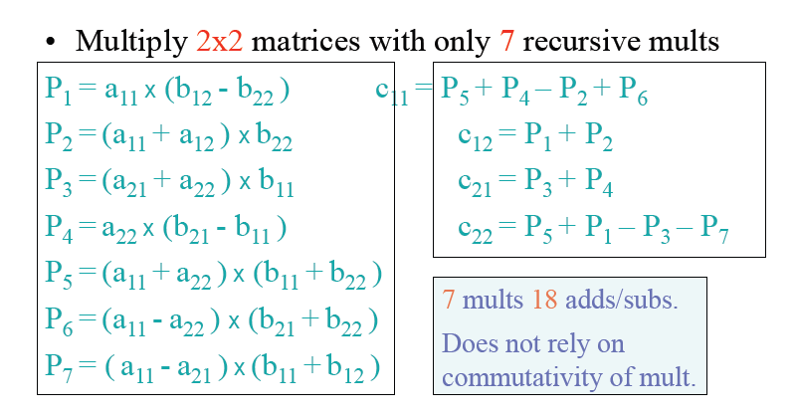
Matrix Multiplication - Strassen’s Idea
Analysis of Algorithms

Slide 59
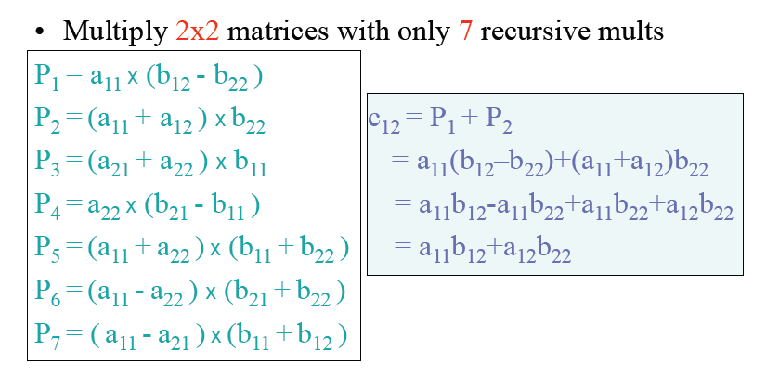
Matrix Multiplication - Strassen’s Idea
Analysis of Algorithms

Slide 60
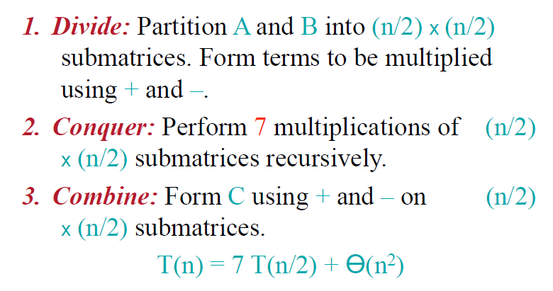
Matrix Multiplication - Strassen’s Idea
Analysis of Algorithms

Slide 61
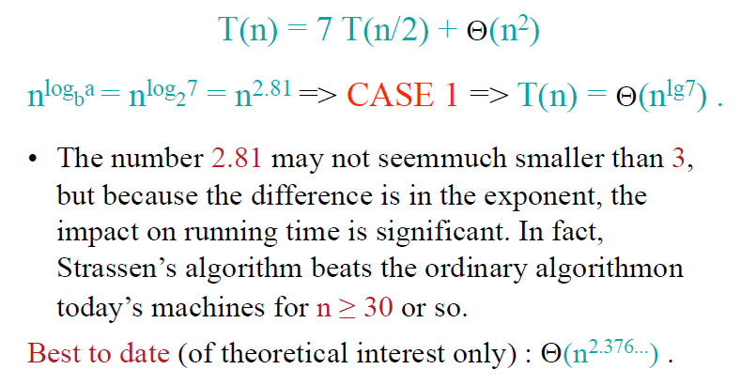
Matrix Multiplication - Analysis of Strassen
Analysis of Algorithms

